Slide 1


Ugur Polat
20.10.2026

Slide 2

Outline
Executive Summary
Introduction
Methodology
Results
Conclusion
Appendix

Slide 3
Executive Summary
Summary of methodologies
Summary of all results

Slide 4
Introduction
Project background and context
Problems you want to find answers

Slide 5

Section 1

Slide 6
Methodology
Executive Summary
Data collection methodology:
  Describe how data was collected
Perform data wrangling
  Describe how data was processed
Perform exploratory data analysis (EDA) using visualization and SQL
Perform interactive visual analytics using Folium and Plotly Dash
Perform predictive analysis using classification models
  How to build, tune, evaluate classification models

Slide 7
Data Collection
Describe how data sets were collected.
Data was collected from the SpaceX REST API and Wikipedia launch records. The data was extracted, combined, cleaned, and prepared for analysis.

Slide 8
Data Collection – SpaceX API
Data Collection using SpaceX REST API
Connected to the SpaceX REST API
Retrieved Falcon 9 launch records
Collected rocket, payload, launch site, and core data
https://github.com/DsUgurPolat/010-Angewandte-Datenwissenschaft-Capstone/blob/main/Modul%201/004%20jupyter-labs-spacex-data-collection-api-v2.ipynb
SpaceX REST API
Retrieve Launch Data
Extract Required Fields(Flight No., Payload,Launch Site, Outcome)
Merge Related Data(Rocket, Payload, Core)
Create DataFrame
Export for Analysis

Slide 9
Data Collection - Scraping
Launch data was collected from Wikipedia using web scraping techniques. HTML tables were extracted, parsed, cleaned, and converted into a structured dataset for analysis.
https://github.com/DsUgurPolat/010-Angewandte-Datenwissenschaft-Capstone/blob/main/Modul%201/005%20jupyter-labs-webscraping.ipynb
Wikipedia Page
Retrieve HTML Content
Extract Launch Tables
Parse Required Fields
Clean & Transform Data
Create DataFrame
Store Dataset

Slide 10
Data Wrangling
Cleaned the collected data, handled missing values, selected relevant Falcon 9 launches, and prepared the dataset for exploratory analysis and machine learning
Raw Data-Remove Missing Values-Filter Falcon 9 Launches-Create Landing Outcome Label-Select Relevant Features-Clean Dataset-Ready for Analysis
https://github.com/DsUgurPolat/010-Angewandte-Datenwissenschaft-Capstone/blob/main/Modul%201/007%20labs-jupyter-spacex-Data%20wrangling-v2.ipynb

Slide 11
EDA with Data Visualization
Charts Used
Flight Number vs. Launch Site (Scatter Plot)
Payload Mass vs. Launch Site (Scatter Plot)
Success Rate by Orbit Type (Bar Chart)
Payload Mass vs. Orbit Type (Scatter Plot)
Yearly Launch Success Trend (Line Chart)

Slide 12
EDA with Data Visualization
Purpose
Explore relationships between launch variables
Identify factors affecting landing success
Analyze trends and patterns in Falcon 9 launches
Support feature selection for predictive modeling
Data visualization was used to identify patterns, trends, and correlations between launch site, payload mass, orbit type, and mission success.
https://github.com/DsUgurPolat/010-Angewandte-Datenwissenschaft-Capstone/blob/main/Modul%202/003%20jupyter-labs-eda-dataviz-v2.ipynb

Slide 13
EDA with SQL
SQL queries were used to explore launch records, payload statistics, landing outcomes, mission success rates, and booster performance.
https://github.com/DsUgurPolat/010-Angewandte-Datenwissenschaft-Capstone/blob/main/Modul%202/002%20jupyter-labs-eda-sql-coursera_sqllite.ipynb

Slide 14
Build an Interactive Map with Folium
Folium maps were used to visualize launch sites, mission outcomes, and nearby geographical features. These map objects helped identify location patterns and understand the operational environment of each launch site.
Map Objects Created
Markers for SpaceX launch sites
Colored markers for launch outcomes (success/failure)
Circle markers to highlight launch locations
Lines connecting launch sites to nearby infrastructure
Distance markers showing proximity to roads, railways, coastlines, and cities

Slide 15
Build an Interactive Map with Folium
Why These Objects Were Added
  Markers identify launch site locations.
  Colored markers visualize mission outcomes.
  Circle markers improve location visibility.
  Lines show relationships between launch sites and nearby features.
  Distance markers help analyze factors that may influence launch operations.
https://github.com/DsUgurPolat/010-Angewandte-Datenwissenschaft-Capstone/blob/main/Modul%203/002_lab-jupyter-launch-site-location-v2.ipynb

Slide 16
Build a Dashboard with Plotly Dash
A Plotly Dash dashboard was developed to visualize launch success rates and the impact of payload mass on mission outcomes. Interactive filters enabled dynamic exploration of launch data.
Plots/Graphs Added
  Pie Chart: Launch success count by launch site
  Pie Chart: Success rate for a selected launch site
  Scatter Plot: Payload Mass vs. Launch Outcome
  Payload Range Slider: Interactive payload filtering
  Launch Site Dropdown: Interactive site selection

Slide 17
Build a Dashboard with Plotly Dash
Why These Interactions Were Added
  Compare launch performance across sites
  Analyze launch success rates
  Explore the relationship between payload mass and landing outcome
  Allow users to filter and investigate specific launch conditions
  Improve data exploration through interactive visualization
https://github.com/DsUgurPolat/010-Angewandte-Datenwissenschaft-Capstone/blob/main/Modul%203/003_Build_a_Dashboard.ipynb

Slide 18
Predictive Analysis (Classification)
Best performing classification model Short Summary
  Selected relevant features and standardized data.
  Split the dataset into training and testing sets.
  Built Logistic Regression, SVM, Decision Tree, and KNN models.
  Tuned model parameters using GridSearchCV.
  Compared classification accuracy on test data.
  Selected the model with the highest accuracy as the final classifier.

Slide 19
Predictive Analysis (Classification)
Model Development Flowchart
  Prepared Dataset
  Feature Selection
  Data Standardization
  Train-Test Split
  Build Classification Models
  (Logistic Regression,
  SVM, Decision Tree,
  KNN)
  Hyperparameter Tuning
  (GridSearchCV)
  Evaluate Accuracy
  Select Best Model
https://github.com/DsUgurPolat/010-Angewandte-Datenwissenschaft-Capstone/blob/main/Modul%204/002_SpaceX-Machine-Learning-Prediction-Part-5-v1.ipynb

Slide 20
Results
Exploratory Data Analysis Results
Launch success rate improved over time.
Payload mass and orbit type influenced landing success.
Some launch sites achieved higher success rates than others.
Successful landings became more frequent in later missions.

Slide 21
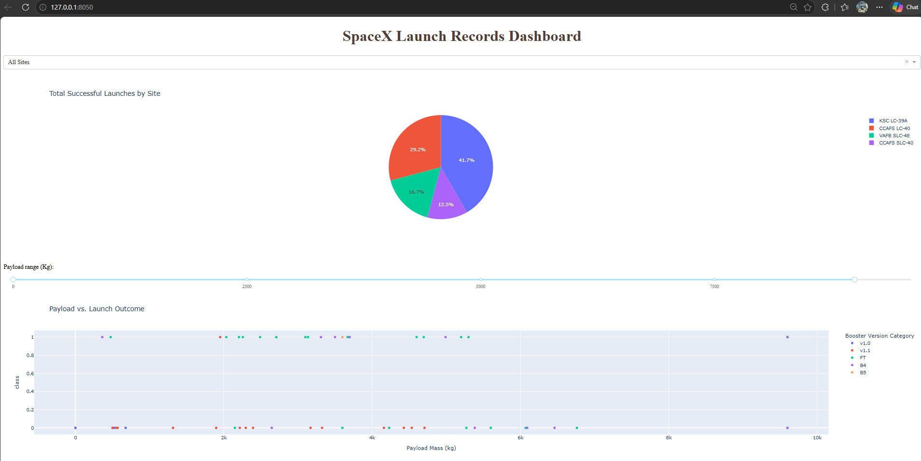
Results
Interactive analytics demo in screenshots

Slide 22
Results
Predictive Analysis Results
  Multiple classification models were trained and evaluated.
  Hyperparameter tuning improved model performance.
  The best model achieved the highest prediction accuracy.
  The final model successfully predicted Falcon 9 landing outcomes.

Slide 23

Section 2

Slide 24
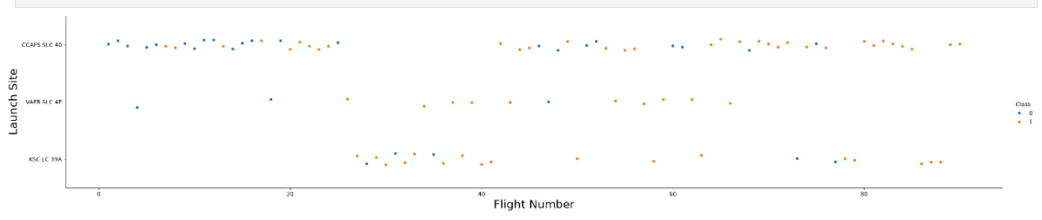
Flight Number vs. Launch Site
Scatter plot of Flight Number vs. Launch Site
The scatter plot shows that launch activity expanded over time and became more successful as SpaceX gained operational experience. Florida launch sites handled most missions, while VAFB supported specialized orbit launches.

Slide 25
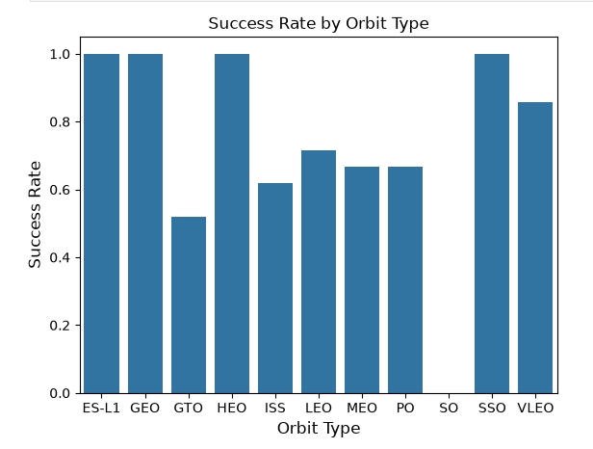
Success Rate vs. Orbit Type
The bar chart shows that mission success rates vary across orbit types. LEO missions achieved consistently high success rates, while GTO missions were more challenging and exhibited a lower success rate. Overall, Falcon 9 demonstrated strong performance across most orbit categories.

Slide 26
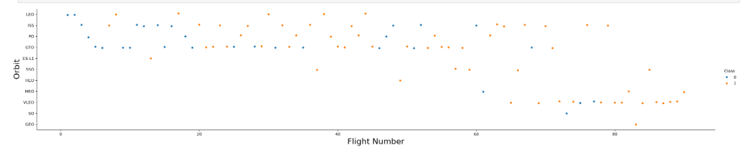
Flight Number vs. Orbit Type
The orbit type is an important factor affecting mission success. Higher success rates were observed for several orbit categories, while GTO missions presented greater operational challenges.

Slide 27
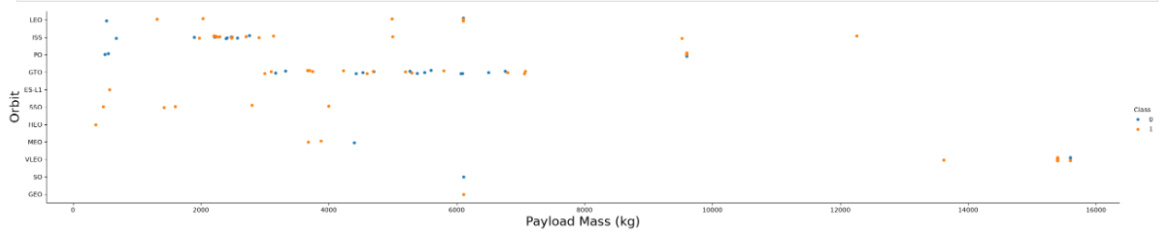
Payload vs. Orbit Type
The scatter plot shows the relationship between payload mass and orbit type. Different orbit categories require different payload capacities, which influences mission characteristics. While heavier payloads can increase mission complexity, SpaceX achieved successful landings across multiple orbit types and payload ranges.

Slide 28
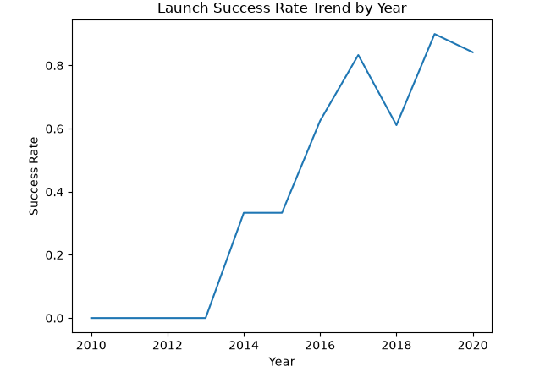
Launch Success Yearly Trend
Explanation
The line chart illustrates the yearly average launch success rate. The upward trend indicates continuous improvements in Falcon 9 performance, landing procedures, and operational efficiency. Over time, SpaceX achieved more reliable launch outcomes and booster recoveries.

Slide 29
All Launch Site Names
Query Result
  CCAFS LC-40
  CCAFS SLC-40
  KSC LC-39A
  VAFB SLC-4E
Short Explanation
The SQL query was used to identify all unique SpaceX launch sites in the dataset. Most launches were conducted from Florida launch facilities (CCAFS and KSC), while VAFB SLC-4E supported missions to polar and sun-synchronous orbits.

Slide 30
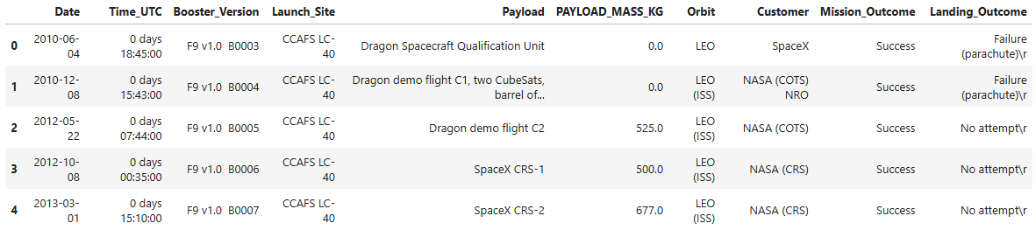
Launch Site Names Begin with 'CCA'
The SQL query filtered launch records where the launch site name begins with "CCA". The results show that Cape Canaveral Air Force Station (CCAFS) was one of SpaceX's primary launch locations and hosted numerous Falcon 9 missions.

Slide 31
Total Payload Mass
Query Result
Total Payload Mass Carried by NASA Boosters: 45,596 kg
Short Explanation
The SQL query calculated the total payload mass transported on NASA missions. The result shows that Falcon 9 boosters carried a combined payload of 45,596 kg for NASA-related launches, demonstrating SpaceX's significant contribution to NASA space missions.

Slide 32
Average Payload Mass by F9 v1.1
Query Result
Average Payload Mass Carried by F9 v1.1: 2,928.4 kg
Short Explanation
The SQL query calculated the average payload mass carried by the Falcon 9 v1.1 booster version. The result shows that F9 v1.1 missions transported an average payload of 2,928.4 kg, providing insight into the launch capabilities of this booster configuration.

Slide 33
First Successful Ground Landing Date
Query Result
First Successful Ground Landing Date: 2015-12-22
Short Explanation
The SQL query identified the first mission that achieved a successful landing on a ground pad. This milestone demonstrated SpaceX's progress in developing reusable rocket technology and paved the way for routine booster recovery.

Slide 34
Successful Drone Ship Landing with Payload between 4000 and 6000
Query Result
  F9 FT B1022
  F9 FT B1026
  F9 FT B1021.2
  F9 FT B1031.2
Short Explanation
The SQL query identified booster versions that successfully landed on a drone ship while carrying payloads between 4,000 kg and 6,000 kg. The results demonstrate Falcon 9's ability to recover boosters successfully even during medium-payload missions.

Slide 35
Total Number of Successful and Failure Mission Outcomes
Query Result
  Successful Missions: 100
  Failed Missions: 1
Short Explanation
The SQL query counted all mission outcomes in the dataset. The results show that successful missions significantly outnumbered failed missions, reflecting the continuous improvement and reliability of the Falcon 9 launch system.

Slide 36
Boosters Carried Maximum Payload
Query Result
F9 B5 B1048.4
F9 B5 B1049.4
F9 B5 B1051.3
F9 B5 B1056.4
F9 B5 B1048.5
F9 B5 B1051.4
F9 B5 B1049.5
F9 B5 B1060.2
F9 B5 B1058.3
F9 B5 B1051.6
F9 B5 B1060.3
F9 B5 B1049.7
Short Explanation
The SQL query identified the Falcon 9 Block 5 boosters that carried the maximum payload mass recorded in the dataset. Multiple booster cores achieved this payload capacity, demonstrating the high performance and operational reliability of the Falcon 9 Block 5 generation.

Slide 37
2015 Launch Records
Query Result
Month | Landing Outcome | Booster Version | Launch Site
January | Failure (drone ship) | F9 v1.1 B1012 | CCAFS LC-40
April | Failure (drone ship) | F9 v1.1 B1015 | CCAFS LC-40
Short Explanation
The SQL query identified all failed drone ship landing attempts in 2015. Two Falcon 9 v1.1 missions failed to land successfully on the drone ship, both launched from CCAFS LC-40. These early failures provided valuable experience that helped SpaceX improve its booster recovery technology in later missions.

Slide 38
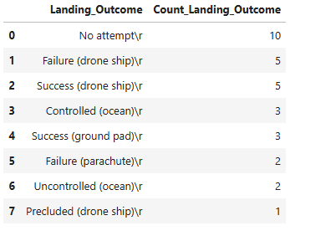
Rank Landing Outcomes Between 2010-06-04 and 2017-03-20
Short Explanation
The landing outcomes were ranked by frequency between 2010 and 2017. "No attempt" was the most common outcome with 10 missions. Both successful and failed drone ship landings occurred 5 times, reflecting SpaceX's early efforts to develop reusable booster technology. Successful ground pad landings and controlled ocean landings became more frequent as recovery capabilities improved.

Slide 39

Section 3

Slide 40
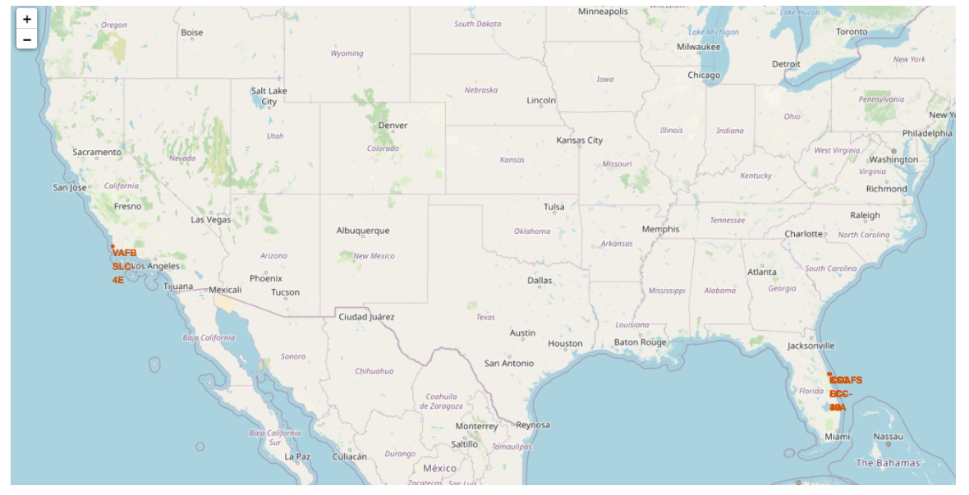
Global Distribution of SpaceX Launch Sites
The Folium map visualizes all SpaceX launch sites using location markers. The map shows that SpaceX primarily operates from Florida launch facilities, while VAFB SLC-4E supports specialized missions from the west coast. The geographic distribution of launch sites enables flexibility for different launch trajectories and mission objectives.

Slide 41
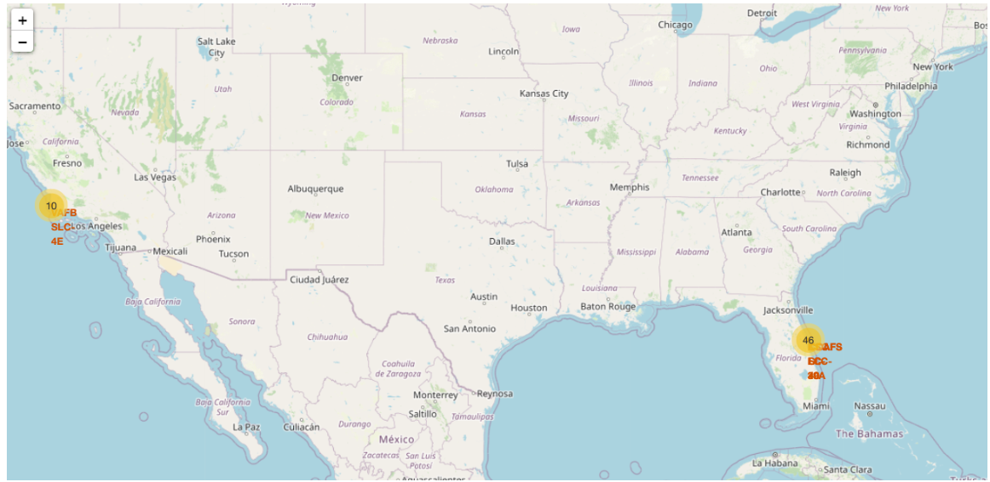
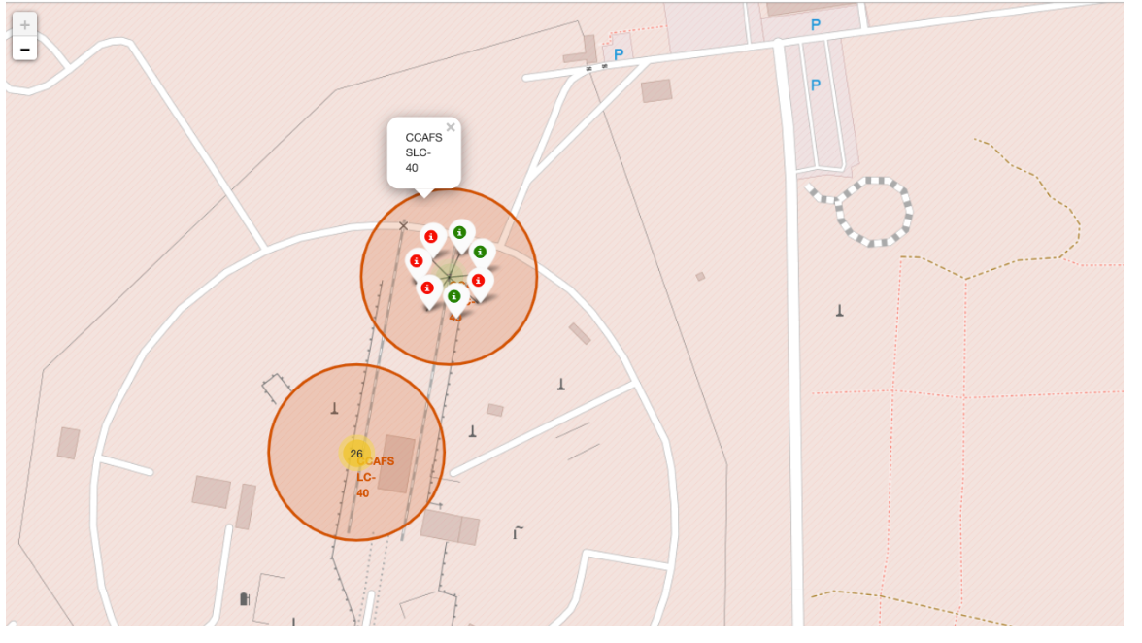
Launch Outcomes Visualization on Folium Map
The Folium map uses color-coded markers to visualize launch outcomes. Green markers indicate successful landings, while red markers indicate failures. The distribution of colors shows that successful recoveries became increasingly common as SpaceX improved its booster landing technology.

Slide 42
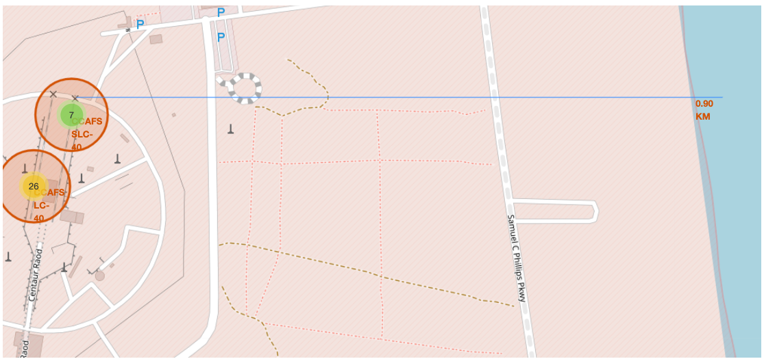
Launch Site Proximity Analysis
The Folium map visualizes the selected launch site's proximity to nearby infrastructure and geographical features. Distance measurements to the coastline, highways, and railways help evaluate the operational advantages of the launch location. The analysis shows that SpaceX launch sites are strategically positioned to balance safety, accessibility, and mission requirements

Slide 43

Section 4

Slide 44
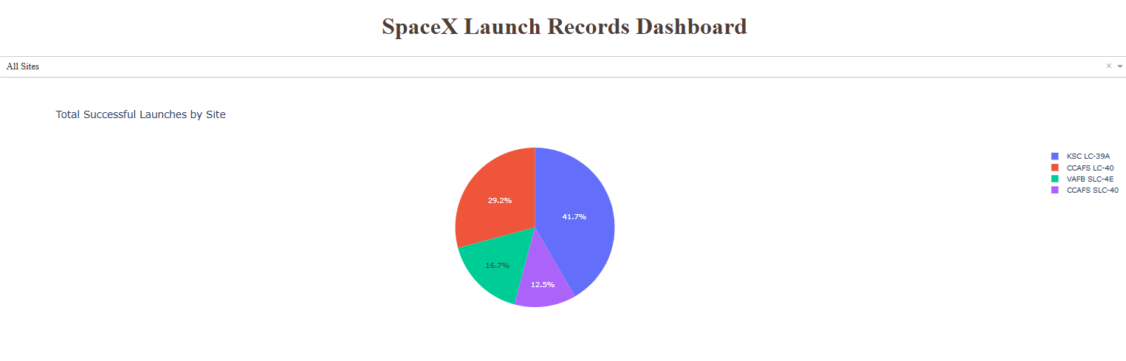
Launch Success Count by Launch Site
The pie chart displays the distribution of successful launches across all SpaceX launch sites. The largest portions correspond to the sites with the highest number of successful missions, demonstrating that Florida-based launch facilities handled most Falcon 9 operations and contributed significantly to overall mission success.

Slide 45
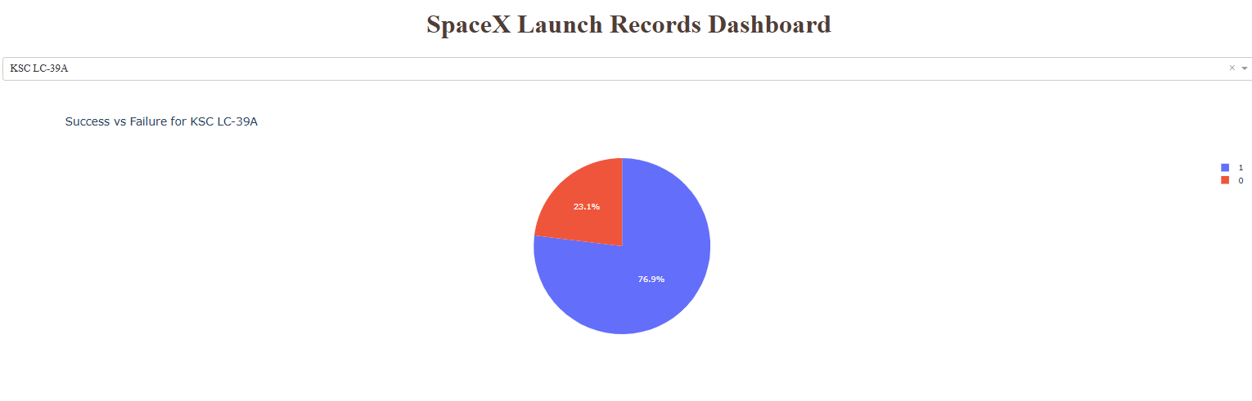
Launch Site with the Highest Success Ratio
The pie chart shows the distribution of successful and unsuccessful launches for the launch site with the highest success ratio. The large proportion of successful missions demonstrates the strong performance and reliability achieved at this location.
Key Takeaway: This launch site recorded the highest launch success ratio, making it one of the most reliable SpaceX launch facilities in the dataset.

Slide 46
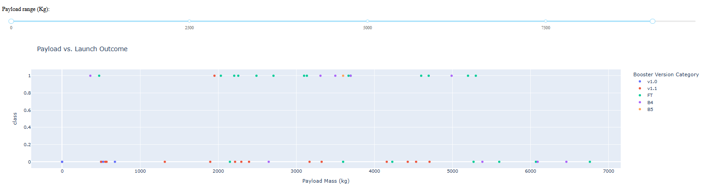
Payload Mass vs. Launch Outcome Analysis
Short Explanation: The scatter plot illustrates the relationship between payload mass and launch outcome. By adjusting the payload range slider, different mission groups can be explored. The results show that successful landings occurred across a wide range of payload masses, indicating that Falcon 9 boosters can reliably recover even during demanding missions.Key TakeawayFalcon 9 achieved high landing success rates across various payload ranges, with newer booster versions delivering the most consistent performance.

Slide 47

Section 5

Slide 48
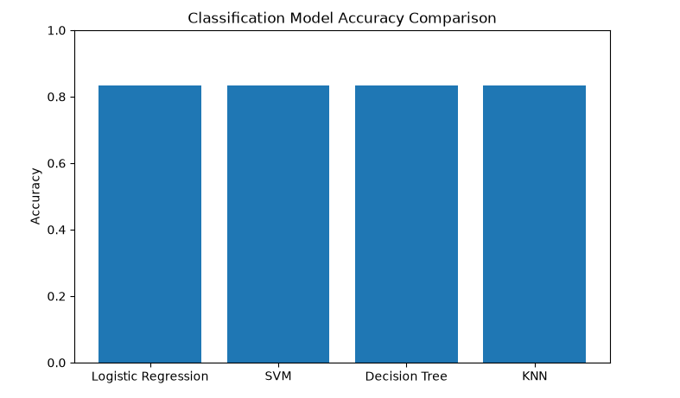
Classification Accuracy
Short ExplanationAll four classification models achieved the same accuracy of 83.33% on the test dataset. Logistic Regression, SVM, Decision Tree, and KNN demonstrated similar predictive performance for Falcon 9 landing outcome prediction.

Slide 49
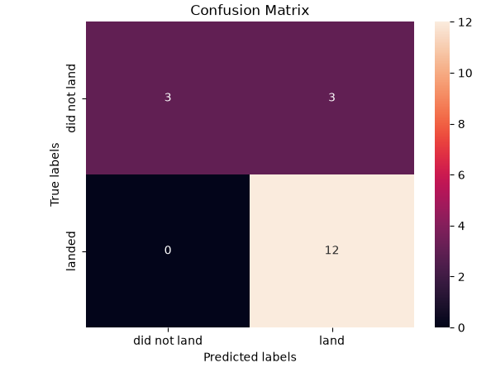
Confusion Matrix
The confusion matrix of KNN
Short Explanation : The confusion matrix shows that the model correctly classified 12 successful landings and 3 unsuccessful landings. No successful landings were missed (0 false negatives). However, 3 unsuccessful landings were incorrectly predicted as successful landings. Overall, the model demonstrates strong performance in predicting Falcon 9 landing outcomes.

Slide 50
Conclusions
Data from the SpaceX API and Wikipedia was successfully collected, cleaned, and prepared for analysis.
Exploratory Data Analysis identified launch site, orbit type, and payload mass as important factors influencing landing success.
Interactive Folium maps and Plotly Dash dashboards provided valuable insights into launch performance and geographic patterns.
Falcon 9 mission success rates improved significantly over time, demonstrating advancements in reusable rocket technology.
Multiple machine learning models were developed and evaluated for landing outcome prediction.
Logistic Regression, SVM, Decision Tree, and KNN all achieved an accuracy of 83.33% on the test dataset.
The predictive models demonstrated that Falcon 9 landing outcomes can be forecasted effectively using historical launch data.
Overall, the project shows how data science techniques can support decision-making and performance analysis in the aerospace industry.

Slide 51
Appendix
Supporting Materials
Python Code
SQL Queries
Dashboard Screenshots
Folium Maps
Model Results
Confusion Matrix
Dataset Samples
GitHub Repository Link

Slide 52


